Slide 1
Tangram, by example
proudly presented in
Fullymugwumpjismtastic,
Multi-Lingwhat?
  Technicolour
  Open Office Impress...

Slide 2
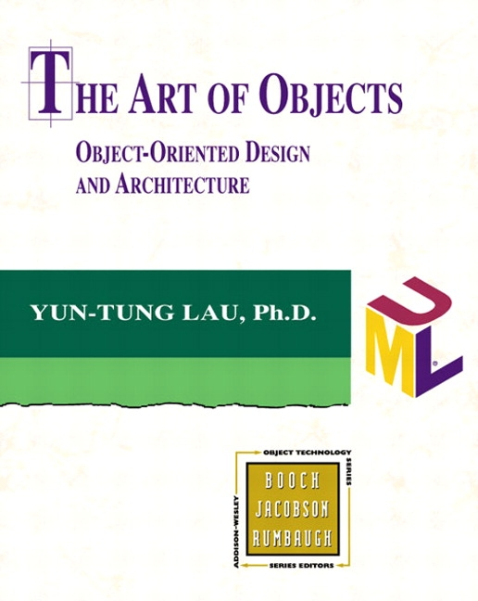
Design Process
process, not details
get requirements
produce specification
RAD prototype
review design & spec.
finalise a set of features and release

Slide 3
1. Identify Requirements
Tips:
  Sit down, listen. No, really listen. You really care for your customer, right?
  Dream up a solution to meet their requirement, expand on their ideas through dialog until what they are saying meets your solution. Remember, if it's the customer's idea, they will like it more – so make them think they thought of it. You don't need their confirmation of how good you are.
  Don't mention too many possible features that they won't need, but plan for when they think of it later, so you don't need to bust a gut to implement it. This takes experience.

Slide 4
Example Requirements
Lexicon for web site
Group phrases together by usage for grouped retrieval, but re-use entries
Support bulk translation via Babelfish
Linguist web interface to edit automatic translation results
Named string placeholders

Slide 5
2. Make a plan, stan!
Re-state your interpretation of the problem
Introduce features in small achievable increments
Use Handy Jismatic Features to Make it look like you truly care about crafting a lavishly decorated and wonderfully radiant interior of custom made software heaven

Slide 6

Functional Specification
Scope
Requirements & Observations
Definitions & Data Model
Use Cases / mock-ups

Slide 7
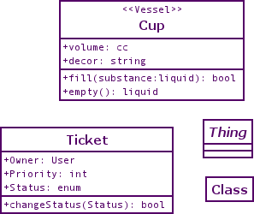

Data Model
UML!
design tools;
  Umbrello, dia, ArgoUML, VT2
Elements:
  Class, Attribute, Method, Association

Slide 8
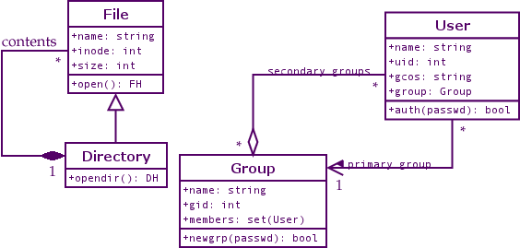
UML Associations
Aggregation
Composition
Inheritance
Multiplicity:
(s_{min}..s_{max}) to (d_{min}..d_{max})

Slide 9
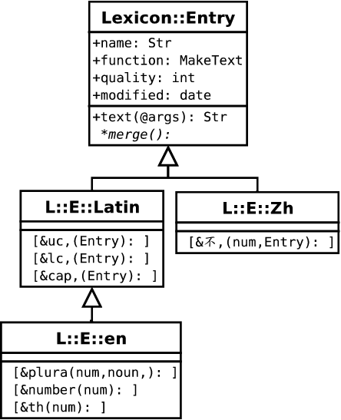
UML Design 1 – Lexicon Entry
Use an inheritance system similar to Locale::MakeText
Focus on good design of the objects, not how Storage works

Slide 10
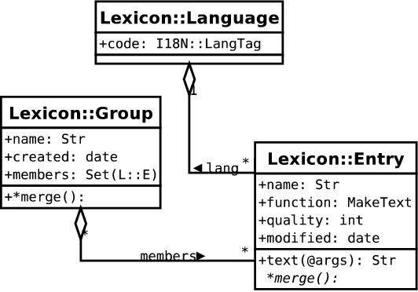
UML Design 2 – Lexicon Groups
Entries are to be grouped by their “usage”
Many to Many, not “composition”

Slide 11
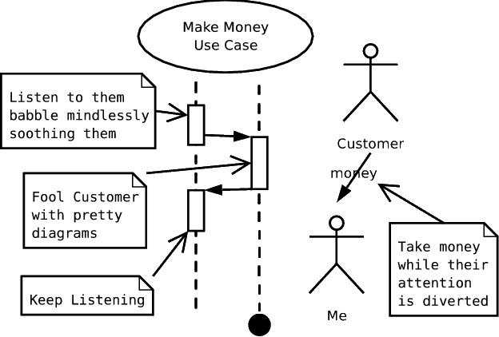

“Use Cases”
Identify how data will be accessed, break down into major categories
Note down and check that each use case is supported by data model
Life is too short for
use case diagrams

Slide 12
UML Design 3 – Use Cases
Linguist & Admin Interface – MVC website
  Check automatic translation
  Browse complete groups
Short Fire Scripts
  per-script message catalog
Daemons & MVC Web Sites
  per-template message catalog
Auto-translating client

Slide 13
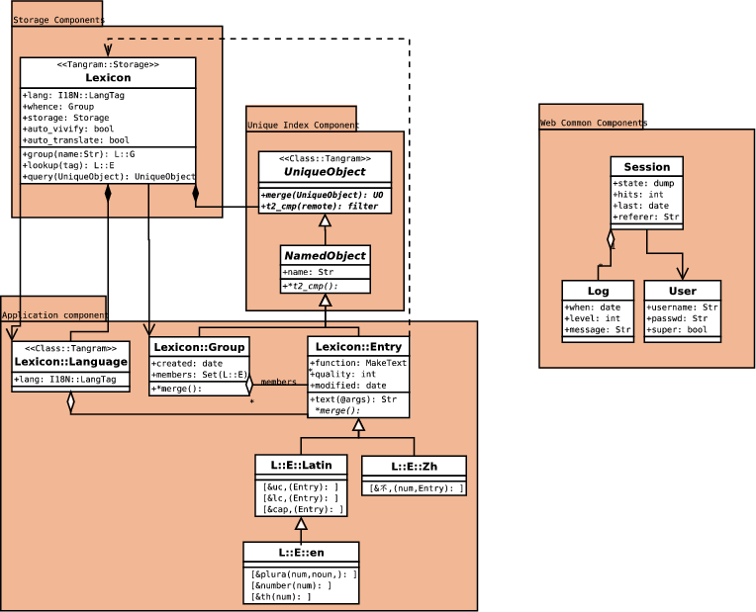
Initial Design

Slide 14
3. Sign-off Design!
Explain design in clear terms to customer
Ready to start implementing!

Slide 15
UML to Tangram - approaches
Start with Class::Tangram classes
Start with an entire Tangram::Schema, using Class::Tangram::Generator
Start with a T2::Schema generated by Visual T2 (perpetuvapourbutonceworkedware)

Slide 16
Starting with Class::Tangram
“Bottom-up” approach
Write synopses
build classes
build tests
package Lexicon::Lang;
use base qw(Class::Tangram);
use Carp;
our $schema = {
fields => {
string => {
lang => {
# /* supports CPD */
sql => “varchar(16)”,
required => 1,
}}}};
sub set_lang {
my $self = shift;
my $lang = shift;
is_language_tag($lang) or croak
(“'$lang' is not in RFC3066”);
$self->SUPER::set_lang($lang);
};
42;

Slide 17
C::T to Tangram::Schema
Simple to add Class::Tangram classes to a schema
Class IDs, mapping can be changed – but be careful of sequence if altering column mapping
sub _schema {
my $schema = { classes => [ ] };
for my $class ( @classes ) {
no strict 'refs';
my $class_schema =
${"${class}::schema"}
or die "no ${class}::schema!";
push @{$schema->{classes}},
$class => $class_schema;
}
$db_schema = Tangram::Schema->new
($schema);
}

Slide 18
Starting with a Tangram::Schema
Write complete schema first
Use Class::Tangram::Generator to get “default” classes
Can still provide .pm files to override default behaviour
Or insert class methods as closures in the Tangram::Schema

Slide 19
C::T::G example code
“Lazy construct” all classes
“Lazy implement” new classes
use Lexicon qw($schema);
Class::Tangram::Generator->new($schema);
my $storage = Tangram::Storage->connect
($schema, $dsn, $u, $p);
# looks for Lexicon/Language.pm for
# overriding methods
my $lang = Lexicon::Language->new
(lang => “zh-tw”);
# Loads Lexicon::Group
my @groups = Tangram::Storage->select
(“Lexicon::Group”);
# Loads Lexicon::Entry and needed
# subclasses
my @entries = $groups[0]->members;

Slide 20
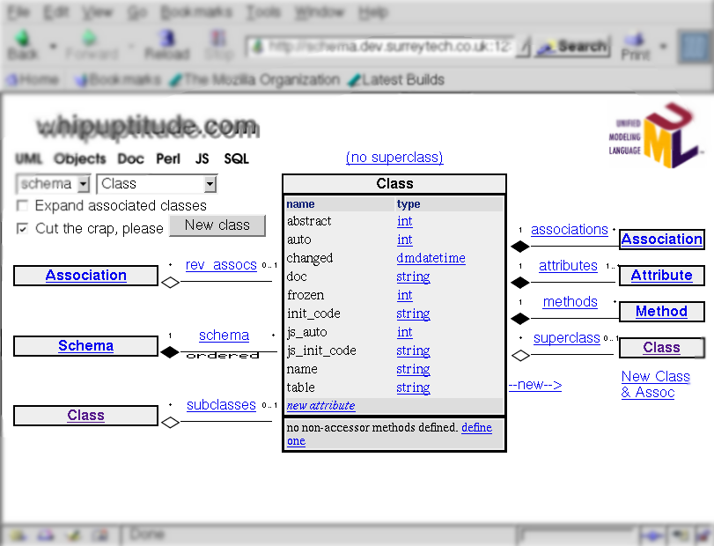
Starting with VT2 and a T2::Schema
Use web-based schema design tool “VT2”
currently fermenting
save “compiled” T2::Schema objects

Slide 21
T2::Schema example code
Similar idea to using C::T::Generator
Could be first piece of code for project!
use T2::Schema;
# loads Storable file etc/lexicon.t2
my $t2s = T2::Schema->read
(“lexicon”);
$t2s->generator;
use Tangram::Storage;
my $lex = Tangram::Storage->connect
($t2s->schema, $dsn, $u, $p);
# combined form – reads DSN info
# from etc/lexicon.dsn
use T2::Storage;
my $storage = T2::Storage->open
(“lexicon”);

Slide 22
Extra Examples 1 – without C::T
Store existing, non-Class::Tangram classes
  t/musicstore/ in Tangram 2.08 dist
  Fink schema

Slide 23
Extra Examples 2 – alien tables
Lots of possible problems;
  The ID conundrum
  Adapting for polymorphism and adding “type” columns
  non-ID joins and 3rd normal forms
  “clever” database hacks
But when it is possible, it's very handy!
Then can use Class::Tangram::Generator

Slide 24
UML to Tangram – the method
Convert persistent properies to Tangram::Scalar or Tangram::IDBIF columns
Inheritance to bases
Associations to Ref, and Coll (eg, Set, Array, Hash)
Roles? Mix-ins? Interfaces? Sorry, not in the meta-model

Slide 25
UML to Tangram – example
package Lexicon::Entry;
use base qw(Class::Tangram);
our $schema = {
fields => {
string => {
name => {}
function => {
sql => “TEXT”
} },
int => {
quality => {
init_default => 1,
} },
timepiece => [qw(modified)],
ref => { qw(lang) },
},
};
sub text {
# ...
package Lexicon::Group;
use base qw(Class::Tangram);
use Time::Piece;
our $schema = {
fields => {
string => [qw(name)],
timepiece => {
created => {
init_default => sub {
localtime
},
},
set => {
members => {
class => “Lexicon::Entry”,
},
}
},
};

Slide 26
Step 4. Write Tests!
Mechanics
  Load classes
  Deploy schema
  Insert / retrieve test objects
Application
  Key object behaviour
  Selection of use cases

Slide 27
Conclusion
Tangram maps objects to a relational database, not a relational database to objects
Tangram can do super-relational things, like trees
Tangram does not “intrude” on objects
Tangram Schemas can be made directly from UML (class diagrams only)
Tangram is designed to facilitate easy iterative design

